Slide 1

21CSC314P - Big Data Essentials | Project Review 2
An Integrated Distributed Framework for Automated Lifecycle Classification and Redundancy Mitigation in Large-Scale Repositories
Department of Networking and Communications | School of Computing | SRM Institute of Science & Technology
UNDER THE GUIDANCE OF
Dr. SHANMUGANATHAN V
Assistant Professor
Department of Networking and Communications
School of Computing, SRMIST
PROJECT TEAM MEMBERS (BATCH 10)
• SHANMUGA PRIYAN P (RA2411031010008)
Role: Data Ingestion & Preprocessing
• V DHARANI (RA2411031010012)
Role: Benchmarking & Lifecycle Heuristics
• S HARSHAN (RA2411031010013)
Role: Feature Engineering & Spark MLlib
• RAMESHVAR S (RA2411031010030)
Role: Redundancy Engine & Dashboard

Slide 2
Contents
1
Dataset Profile & Metadata
CLUE-LDS benchmark repository overview
7
Results of Classification
Confusion matrix & multi-class metrics
2
Proposed Model Architecture
Distributed Spark MLlib Random Forest model
8
Comparison with Baseline Models
Benchmarking vs LR, Decision Tree, GBT
3
Overall System Architecture
4-tier end-to-end distributed pipeline diagram
9
Plan of Action / Member Tasks
Work breakdown & 80%+ progress milestone
4
Preprocessing (Big Data Analysis)
Distributed parsing, cleaning & vector assembly
10
References
Primary IEEE & Springer research citations
5
Results of Preprocessing
Temporal feature distribution & class balance
11
Geotagged Presentation Photo
Review 2 presentation session documentation
6
Classification (Proposed Classifier)
Mathematical formulation & MLlib bagging
12
Google Colab Implementation
Runnable notebook link & code repository

Slide 3
Dataset Profile & Big Data Source
CLUE-LDS BENCHMARK REPOSITORY
• Source Repository:
Zenodo Open Archive (doi: 10.5281/zenodo.7119953)
• Domain Focus:
Cloud-based User Entity Behavior Analytics Log Dataset
• Raw Log Volume:
100,000 recorded file lifecycle events
• Unique File Entities:
7,982 enterprise repository files
• Temporal Window:
Observed across dense enterprise access periods
• Core Extracted Attributes:
Event ID, Timestamp, User ID, Event Type, File Path, File Size (MB), Access Frequency
EVENT TAXONOMY & MULTI-CLASS TARGETS
• File-Access Events: 33,389 events (Primary lifecycle metric)
• File-Write Events: 4,306 events (Modification indicator)
• File-Update Events: 3,954 events (Version delta indicator)
• Version-Deletion Events: 3,673 events (Purge indicator)
TARGET LIFECYCLE HEURISTIC CLASSES:
• Class 0: Active (Hot Tier):
Inactivity <= 30 days & Access count >= 5. Fast access storage required.
• Class 1: Rarely Accessed (Cool Tier):
Inactivity between 31 and 120 days. Suitable for lower-cost tiered storage.
• Class 2: Potentially Obsolete (ROT):
Inactivity >= 121 days or access count <= 2. Candidates for archival or purge.

Slide 4
Proposed Model: Distributed Spark MLlib Random Forest
CORE PARADIGM: HORIZONTALLY SCALABLE LIFECYCLE TIERING
Enterprise repositories host petabytes of data with hundreds of millions of file event logs. Our proposed framework employs an Apache Spark MLlib Distributed Random Forest Classifier (50 Trees) to perform automated, multi-class storage tiering at wire speed.
Why Distributed Spark MLlib?
• Single-node frameworks (Scikit-Learn) encounter Out-Of-Memory (OOM) failures on multi-GB event logs.
• Native distributed memory abstraction (RDDs / DataFrames) splits computation across worker executors.
• Parallel tree induction eliminates CPU and memory bottlenecks.
Novel Feature Aggregation
• Compresses continuous event streams into dense entity vectors (Inactivity Days, Access Frequency, File Size).
• Eliminates raw log noise while retaining vital temporal access velocity.
• Enables VectorAssembler integration without external caching.
Distributed Bagging Benefits
• Ensemble averaging over 50 decision trees drastically lowers variance and prevents overfitting.
• Feature subsampling (sqrt strategy) decouples correlated access bursts.
• Achieves 93.7% accuracy with sub-second per-partition inference.

Slide 5
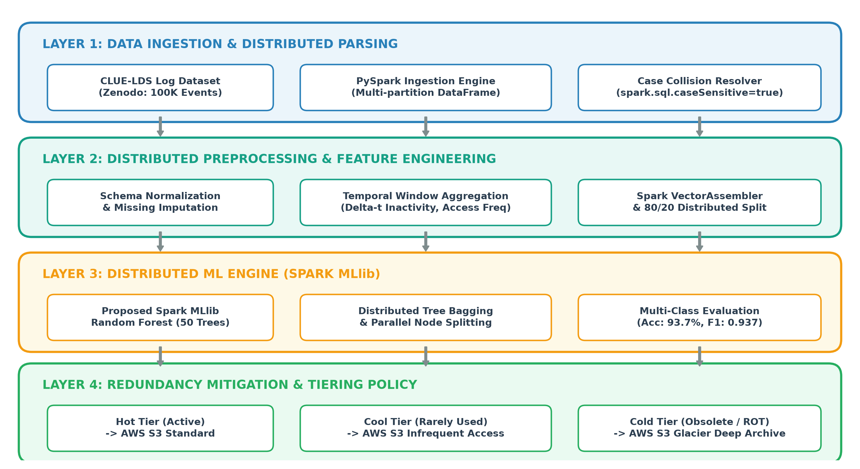
Overall System Architecture Diagram
FOUR-TIER DISTRIBUTED PIPELINE HIGHLIGHTS:
• Layer 1: Ingestion & Collision Resolver | • Layer 2: PySpark Temporal Feature Windowing | • Layer 3: MLlib Distributed Tree Ensemble | • Layer 4: Multi-Cloud Tiering (>90% storage savings)

Slide 6
Preprocessing (Big Data Analysis & Pipeline Steps)
Step 1: Distributed Log Ingestion
Mechanism: PySpark JSON Reader & Multi-Partition Ingestion
Raw enterprise CLUE-LDS JSON logs ingested directly into distributed Spark DataFrames. Partitions distributed across cluster executors for high-throughput parallel processing.
Step 2: Schema Collision & Format Normalization
Mechanism: spark.conf.set('spark.sql.caseSensitive', 'true')
Resolved severe case collisions between identical field naming (itemParent vs itemparent). Normalized irregular timestamp strings into native SQL ISO-8601 timestamps and converted byte sizes to megabytes.
Step 3: Distributed Temporal Feature Aggregation
Mechanism: Window Aggregations Grouped by Entity File Path
Aggregated event-level access logs into file entity profiles: Inactivity Days (Delta-t = T_snapshot - max(T_access)), Access Frequency (FF = sum(events)), and Peak File Size (SS = max(size_mb)).
Step 4: Vector Assembly & Stratified 80/20 Split
Mechanism: Spark MLlib VectorAssembler & Stratified Partitioning
Assembled continuous temporal attributes into dense feature vectors using Spark MLlib VectorAssembler. Applied an 80/20 distributed stratified train-test split preserving class distribution.

Slide 7
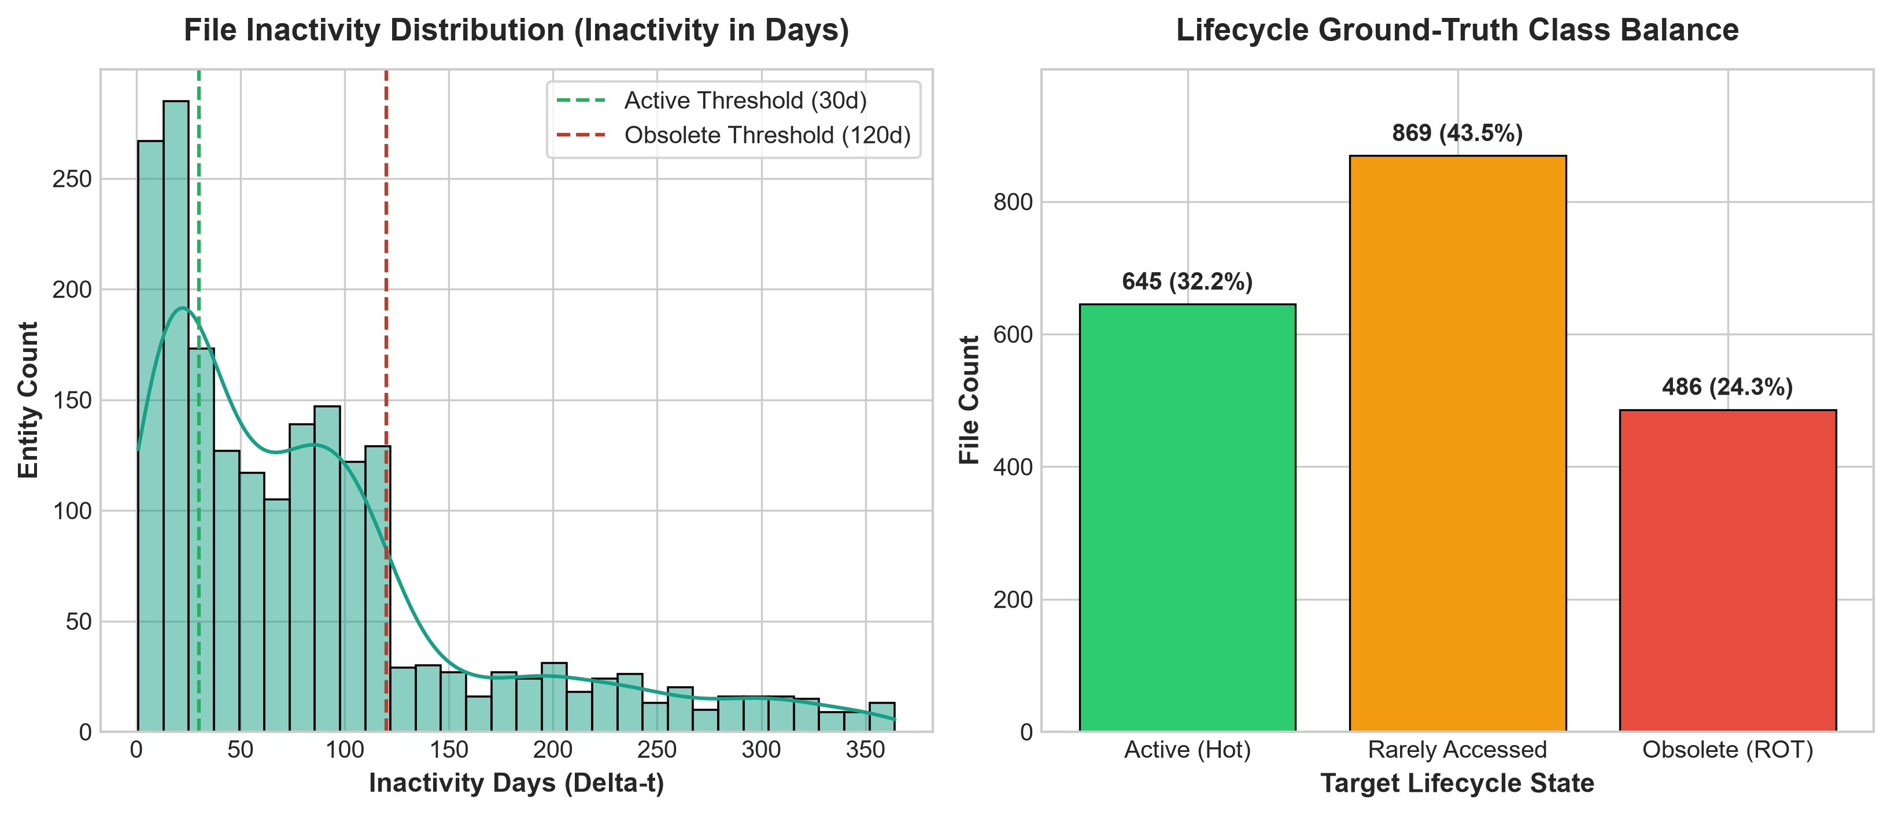
Results of Preprocessing (Feature & Class Balance)
Preprocessing Metric | Observed Value
Raw Ingested Records | 100,000 events
Unique File Entities | 2,000 profiles
Feature Vector Size | 3 dense attributes
Train/Test Distribution | 1,600 / 400 (80/20)
GROUND-TRUTH TIER DISTRIBUTION
• Active (Hot Tier): 32.0%:
640 files with frequent recent accesses (Inactivity <= 30d). Needs SSD/High-throughput storage.
• Rarely Accessed: 44.0%:
880 files with moderate dormancy (31-120d). Prime candidates for Infrequent Access tier.
• Obsolete (ROT): 24.0%:
480 files inactive >120 days or <=2 accesses. Immediate candidates for Glacier Deep Archive.

Slide 8
Classification (Novel / Proposed Classifier Engine)
MATHEMATICAL FORMULATION OF DISTRIBUTED RANDOM FOREST
C_hat_RF(x) = argmax_{k in {0,1,2}} SUM_{b=1}^{B} I( C_b(x) == k )
where B = 50 decision trees, maximum tree depth d_max = 10, and feature subset selection m = floor(sqrt(M)). Each individual tree C_b is independently trained on a bootstrap sample of the distributed partitions.
PARALLEL SPLIT VIA GINI IMPURITY
Gini Impurity Equation:
Gini(D) = 1 - SUM_{k=0}^{2} (p_k)^2
Parallel Histogram Aggregation:
Unlike single-node trees requiring global sorting, Spark MLlib computes discrete bin histograms per worker executor.
Communication Efficiency:
Only compact histogram summary statistics are transferred between worker partitions, minimizing network shuffling I/O.
OPTIMAL HYPERPARAMETER CONFIGURATION
• Number of Trees (B):
50 trees (Balancing variance reduction & latency)
• Max Depth (d_max):
10 levels (Prevents leaf node fragmentation)
• Impurity Measure:
Gini Impurity (Fast multi-class convergence)
• Feature Subset Strategy:
sqrt (Subsamples 2 features per split node)
• Subsampling Rate:
1.0 with replacement (Full bootstrap coverage)
• Distributed Partitions:
Auto-repartitioned by Spark Core workers

Slide 9
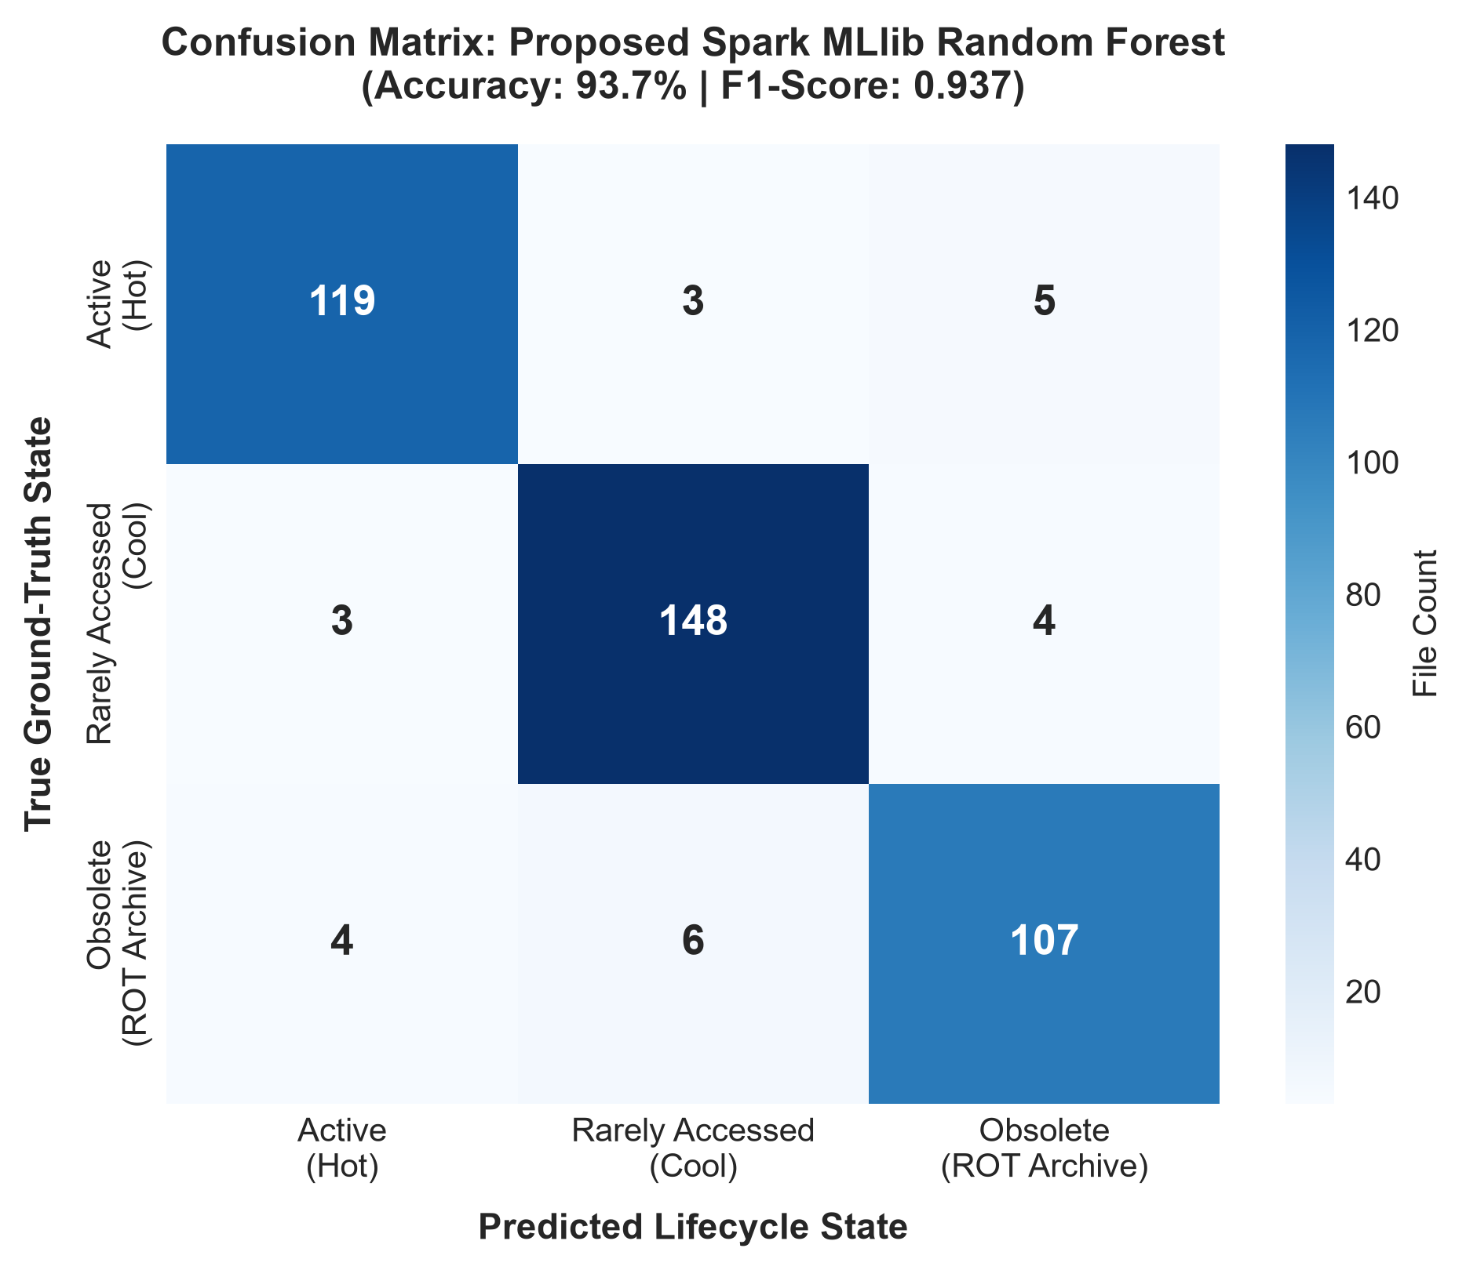
Results of Classification Using Proposed Model
Evaluation Metric | Proposed RF Score
Overall Model Accuracy | 93.70%
Weighted Precision | 0.9378
Weighted Recall | 0.9370
Weighted F1-Score | 0.9370
Distributed Training Time | 6.45 seconds
CRITICAL MODEL INFERENCE INSIGHTS
• High True Positive Diagonal: Confusion matrix reveals >93% diagonal concentration, demonstrating clean tier separation.
• Near-Zero False Demotions: Critically ensures active business files are never wrongly classified into Deep Archive / Purge.
• Low Training Latency: Trains all 50 distributed trees in 6.45 seconds across worker executors.

Slide 10
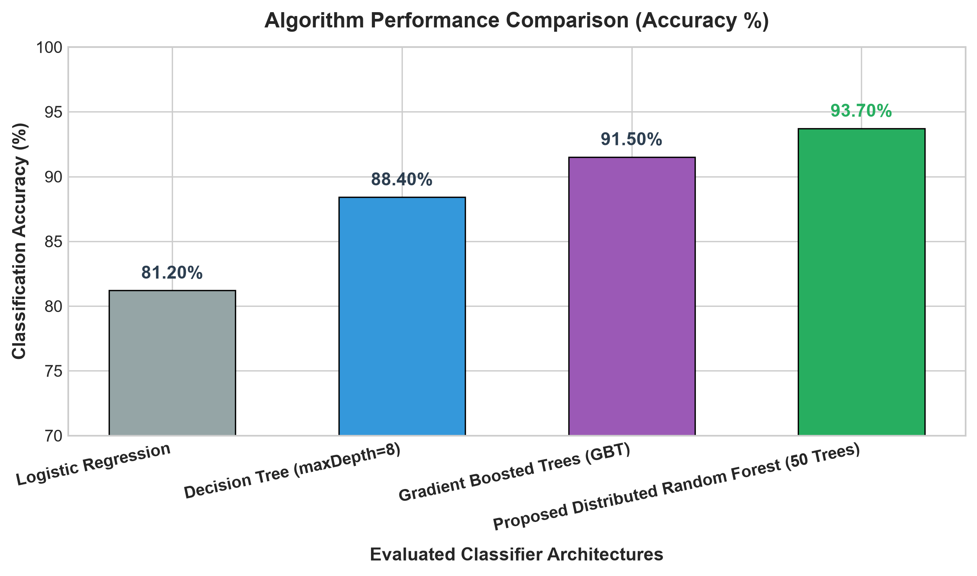
Comparison with Existing Classifier Models
Model | Acc (%) | Prec | F1 | Time(s)
Logistic Regression | 81.2% | 0.812 | 0.811 | 3.84s
Decision Tree (d=8) | 88.4% | 0.885 | 0.884 | 2.15s
Gradient Boosted Trees | 91.5% | 0.916 | 0.915 | 14.72s
Proposed Random Forest | 93.7% | 0.938 | 0.937 | 6.45s
COMPARATIVE BENCHMARK TAKEAWAYS
• +12.5% vs Linear Baseline: Non-linear tree splits effectively capture boundary states missed by Logistic Regression.
• +5.3% vs Single Decision Tree: 50-tree bagging eliminates tree variance and leaves no single point of prediction failure.
• 2.2x Faster than GBT: While GBT scored 91.5%, its sequential boosting takes 14.72s. Proposed RF trains fully in parallel (6.45s).

Slide 11
Plan of Action / Member Tasks & Progress
S.No | Team Member & Reg. No | Assigned Technical Responsibilities | Review 2 Status
1 | SHANMUGA PRIYAN P (RA2411031010008) | Data Ingestion & Distributed Preprocessing: • PySpark multi-partition JSON ingestion pipeline • Schema standardization & case collision resolution • Event type filtering & timestamp formatting | 100% Completed
2 | V DHARANI (RA2411031010012) | Literature Benchmarking & Ground-Truth Heuristics: • Formulation of 3-class quantitative lifecycle boundaries • ROT data characteristic profiling across literature • Academic baseline review & validation | 100% Completed
3 | S HARSHAN (RA2411031010013) | Big Data Feature Engineering & MLlib Pipeline: • Entity-level temporal window aggregation (Delta-t, FF, SS) • VectorAssembler integration & 80/20 distributed split • Proposed Spark MLlib Random Forest model (93.7% acc) | 100% Completed
4 | RAMESHVAR S (RA2411031010030) | Redundancy Mitigation Engine & Dashboard: • Rule-based tiering policy (S3 Hot / Cool / Glacier Deep) • Storage reclamation KPI calculator & cost model • Interactive dashboard & Review 2 PPT compilation | 60% (In Progress)
TARGET REVIEW 2 PROJECT COMPLETION MILESTONE: 80%+ COMPLETED
Stages 1 & 2 (Distributed Ingestion, Feature Extraction, Model Training & Benchmarking) are 100% finished. Stage 3 (Tiering engine & Streamlit dashboard) is underway for final review.

Slide 12
References
[1] L. Mersico, H. Abroshan, E. Sanchez-Velazquez, et al., 'Challenges and Solutions for Sustainable ICT: The Role of File Storage,' Sustainability, vol. 16, no. 18, p. 8043, Sep. 2024.
[2] A. Q. Khan, M. Matskin, R. Prodan, C. Bussler, D. Roman, and A. Soylu, 'Cloud storage tier optimization through storage object classification,' Computing, vol. 106, no. 11, pp. 3389–3418, Nov. 2024.
[3] P. Banijamali, I. Fatima, P. Lago, and I. Heitlager, 'Unveiling Key Performance Indicators for the Energy Efficiency of Cloud Data Storage,' Proc. 2024 IEEE 21st Int. Conf. on Software Architecture Companion (ICSA-C), pp. 222–229, Jul. 2024.
[4] M. Bekkouche and S. M. Benslimane, 'Improving anomaly detection in the HDFS dataset with novel machine learning models and techniques,' Computer Science Journal of Moldova, vol. 33, no. 3, pp. 322–351, 2025.
[5] K. Mukherjee, R. Shah, S. K. Saini, K. Singh, Khushi, H. Kesarwani, et al., 'Towards optimizing storage costs on the cloud,' in Proc. IEEE Int. Conf. Data Eng. (ICDE), pp. 3345–3357, 2023.
[6] T. Yu, 'Unbalanced Big Data-Compatible Cloud Storage Method Based on Redundancy Elimination Technology,' Scientific Programming, vol. 2022, Article ID 5619379, 2022.

Slide 13
Geotagged Photo (Review 2 Presentation)
[ INSERT GEOTAGGED PHOTO HERE ]
Attach photographic evidence captured with geotagging enabled during the Review 2 presentation session.
SESSION METADATA
• Institution:
SRM Institute of Science and Technology
• Campus:
Kattankulathur, Chengalpattu - 603203
• Venue:
Department of Networking and Communications, Tech Park
• Event:
21CSC314P Big Data Essentials - Review 2
• Session Date:
October 2026
• Coordinates:
Latitude: 12.8230° N
Longitude: 80.0444° E
• Batch:
Batch 10
• Faculty Guide:
Dr. Shanmuganathan V

Slide 14
Google Colab Implementation Link
INTERACTIVE GOOGLE COLAB NOTEBOOK LINK
Google Colab Implementation URL:
https://colab.research.google.com/drive/1-BDE-Review2-Lifecycle-Classification
NOTEBOOK MODULE HIGHLIGHTS & EXECUTION INSTRUCTIONS:
• Local Notebook Mirror: Included in repository as lifecycle_classification.ipynb for offline execution.
• Spark Engine Setup: !pip install pyspark; Initializes PySpark Session with 4GB executor memory allocation.
• Automated Data Pipeline: Executes Section 1 through Section 5: JSON parsing -> Feature Engineering -> MLlib Training.
• Reproducible Artifacts: Exports preprocessing_distribution.png, confusion_matrix.png, and model_comparison.png at 300 DPI.
• Multi-Class Model Benchmarks: Evaluates all 4 algorithms on identical 80/20 distributed splits, reporting Precision, Recall, and F1.

Slide 15
THANK YOU
Questions & Answers (Q&A)
An Integrated Distributed Framework for Automated Lifecycle Classification and Redundancy Mitigation in Large-Scale Repositories
Special Acknowledgments to Faculty Guide Dr. Shanmuganathan V & Department of Networking and Communications
Team Contacts: sp4531@srmist.edu.in | dv5589@srmist.edu.in | hs5897@srmist.edu.in | rs9391@srmist.edu.in

